Slide 1
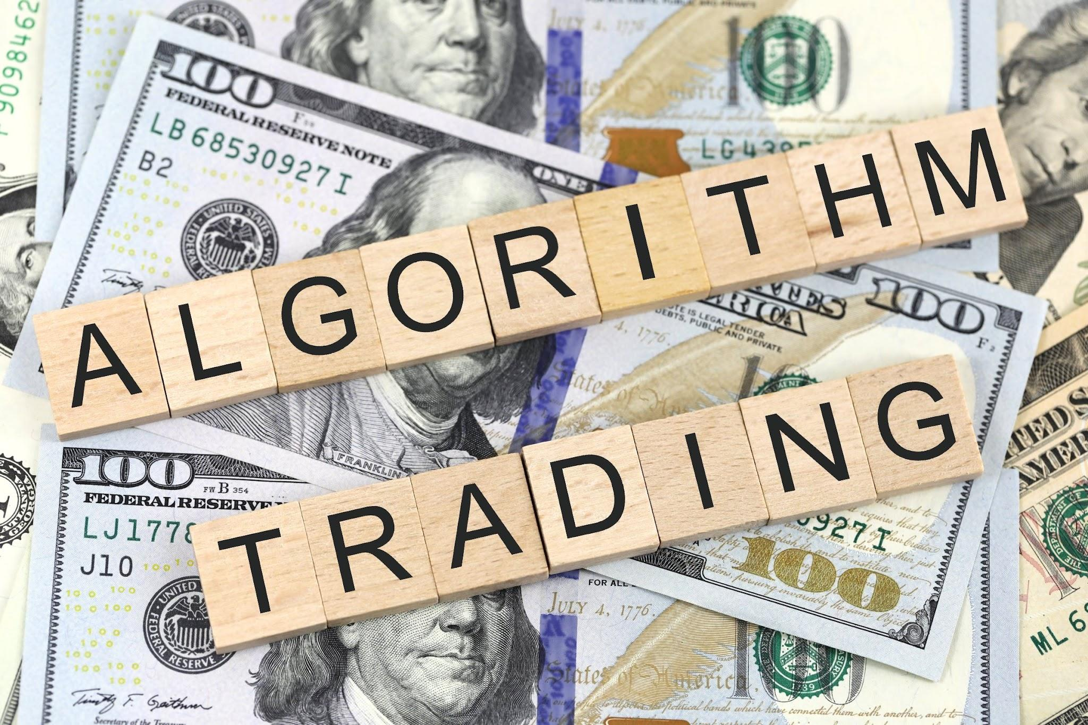
Machine Learning Trading Ideas
By Joshua Woods, David Lewis, Hardy Ty, Anna Zhao

Slide 2
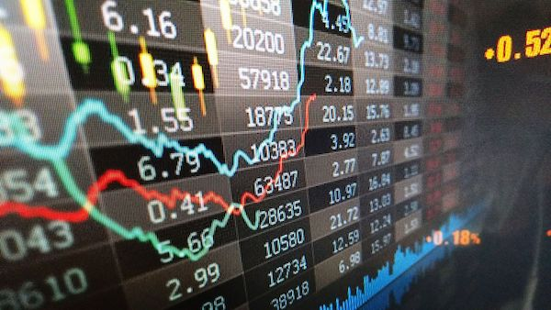
Motivation
With a couple keen traders in the group we were interested to see what machine learning modules we could use to generate returns outperforming the Bitcoin-AUD daily returns.
We used the SVM and linear regression classifiers and also a neural network to try and outperform the market.

Slide 3

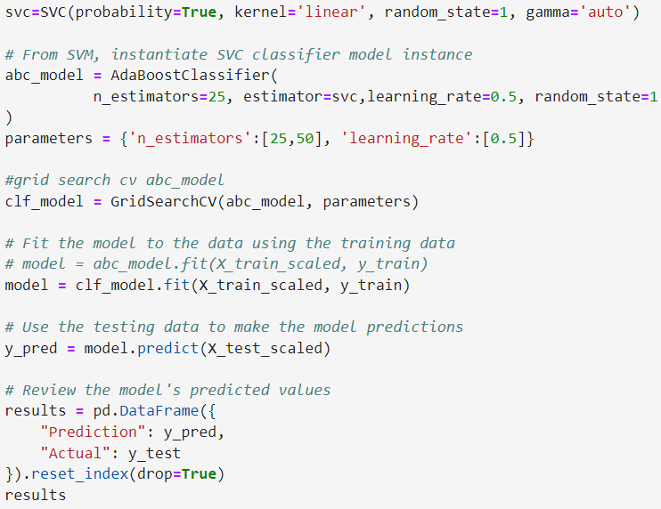
SVM & Adaboost Model Summary
I decided to use the Support Vector Machine classifier with the Adaboost classifier to try and create a model that outperformed the BTC-AUD daily time-frame buy and hold strategy. I also used the GridSearchCV to help find some optimal parameters.

Slide 4
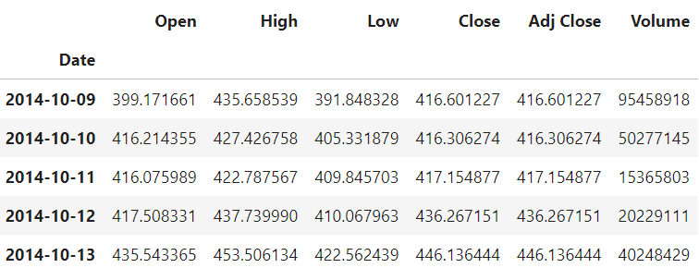
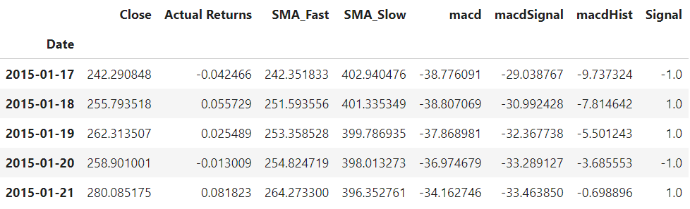
SVM Data Cleanup & Model Training
BTC-AUD data original - open, high, low, close, adj close, volume.
Remove all data apart from close.
Added indicators - SMA_fast(4), SMA_slow(100) and MACD(12,26,9).
Used signal of -1 for negative daily change and +1 for positive daily change to train the model.
X = SMA_Fast, SMA_Slow, macd, macdSignal and macdHist.
Y = Signal

Slide 5
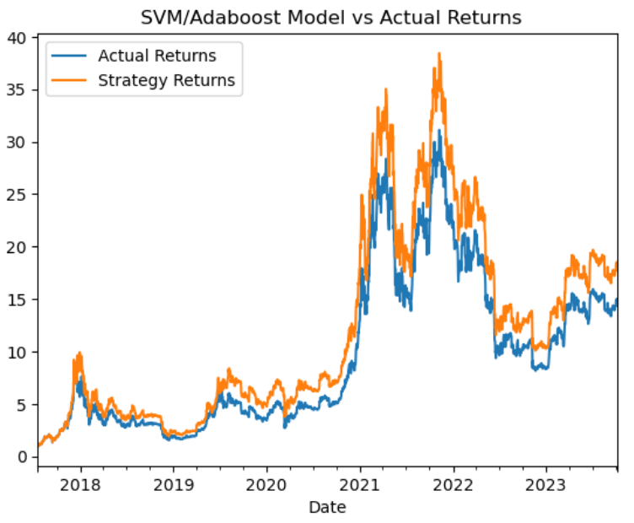
SVM Model Evaluation
As you can see to the right my model closely mimicked the actual returns but did out perform slightly. The results are also only plotted on the test data and the training data has been left out. I trained the model on 30months worth of daily data.

Slide 6
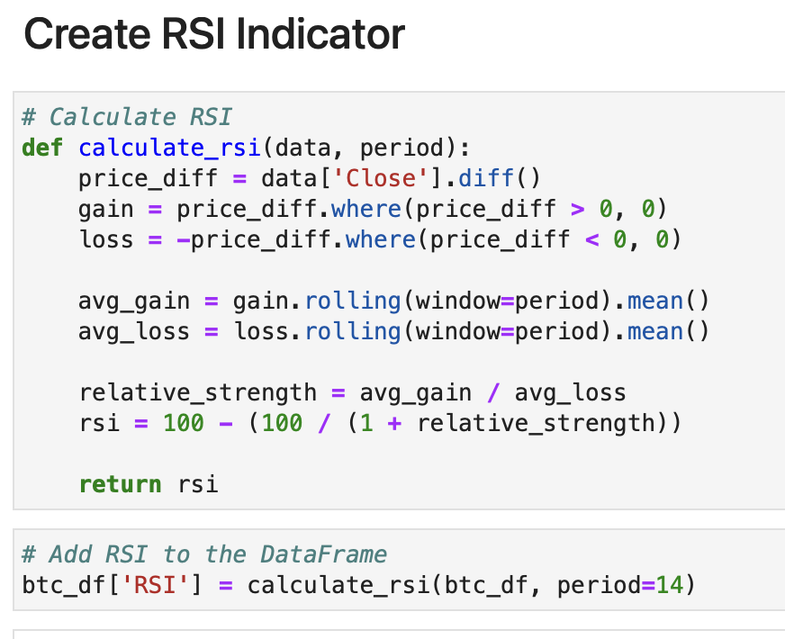
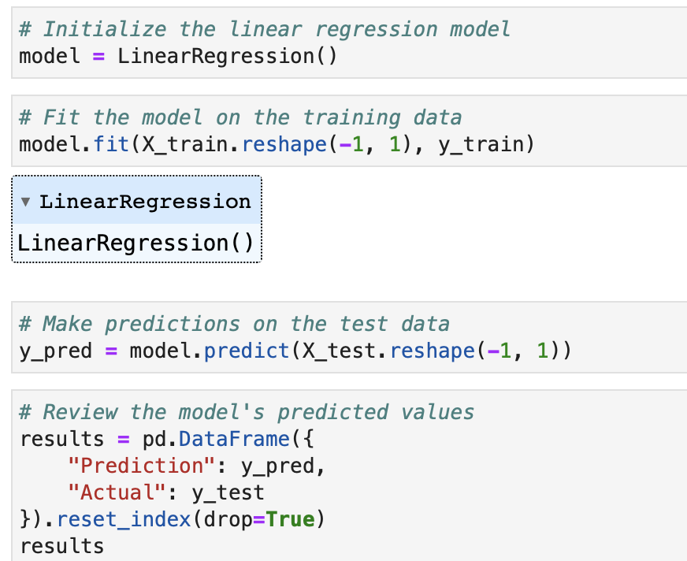
RSI Indicator & Linear Regression Model Summary
I used RSI as indicator and Linear Regression as ml model because while RSI can help identify potential entry and exit points based on short-term market conditions that, I think is the best strategy given the volatility of BTC, linear regression complements it by providing the broader trend perspective. Also, for linear regression’s simplicity and explainability being a basic machine learning model.

Slide 7
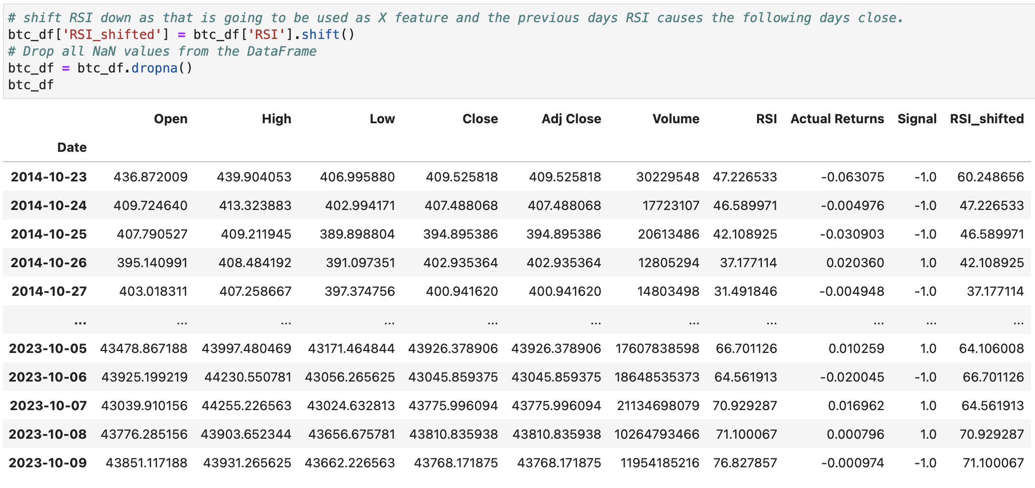
LR Data Cleanup & Model Training
Drop all NaN and Set ‘RSI_shifted’ and ‘Close’ columns as the feature and target values, respectively.

Slide 8
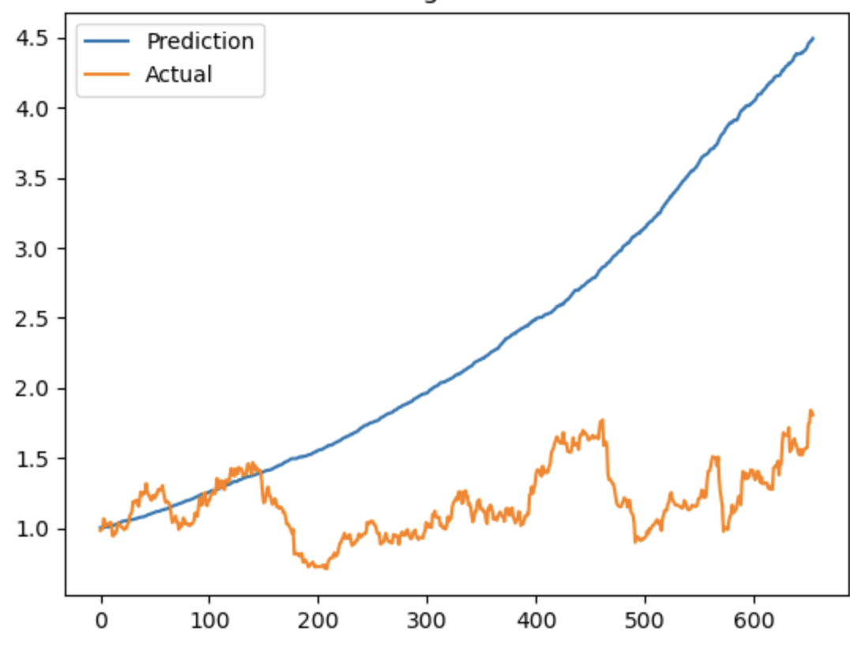
Linear Regression Model Evaluation
The predicted returns outperforms the actual returns in this Linear Regression model.

Slide 9
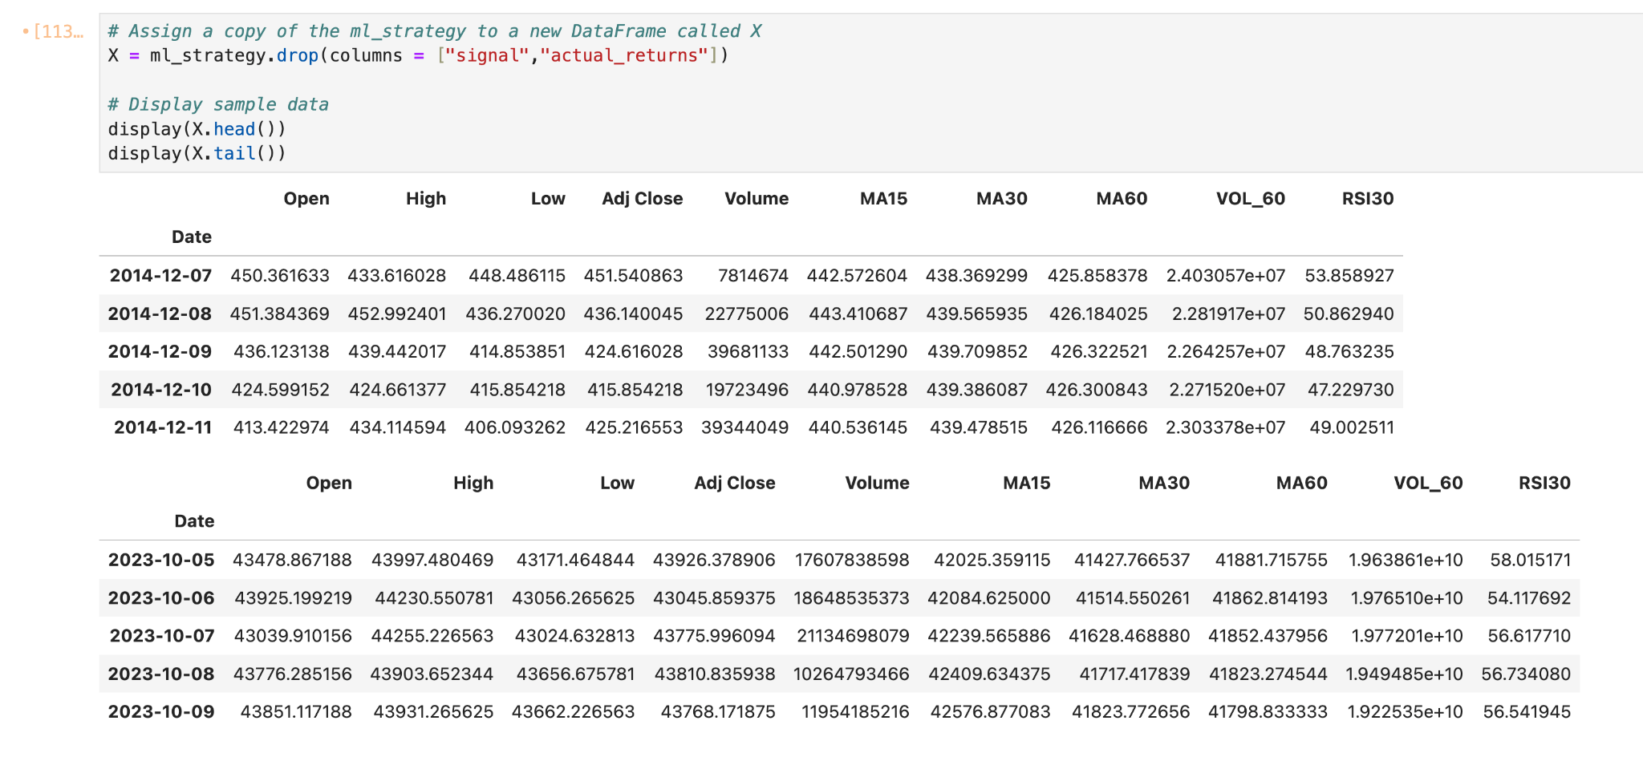
Neural Network Model Summary
Data Feed
X
Training Window: 60 months

Slide 10
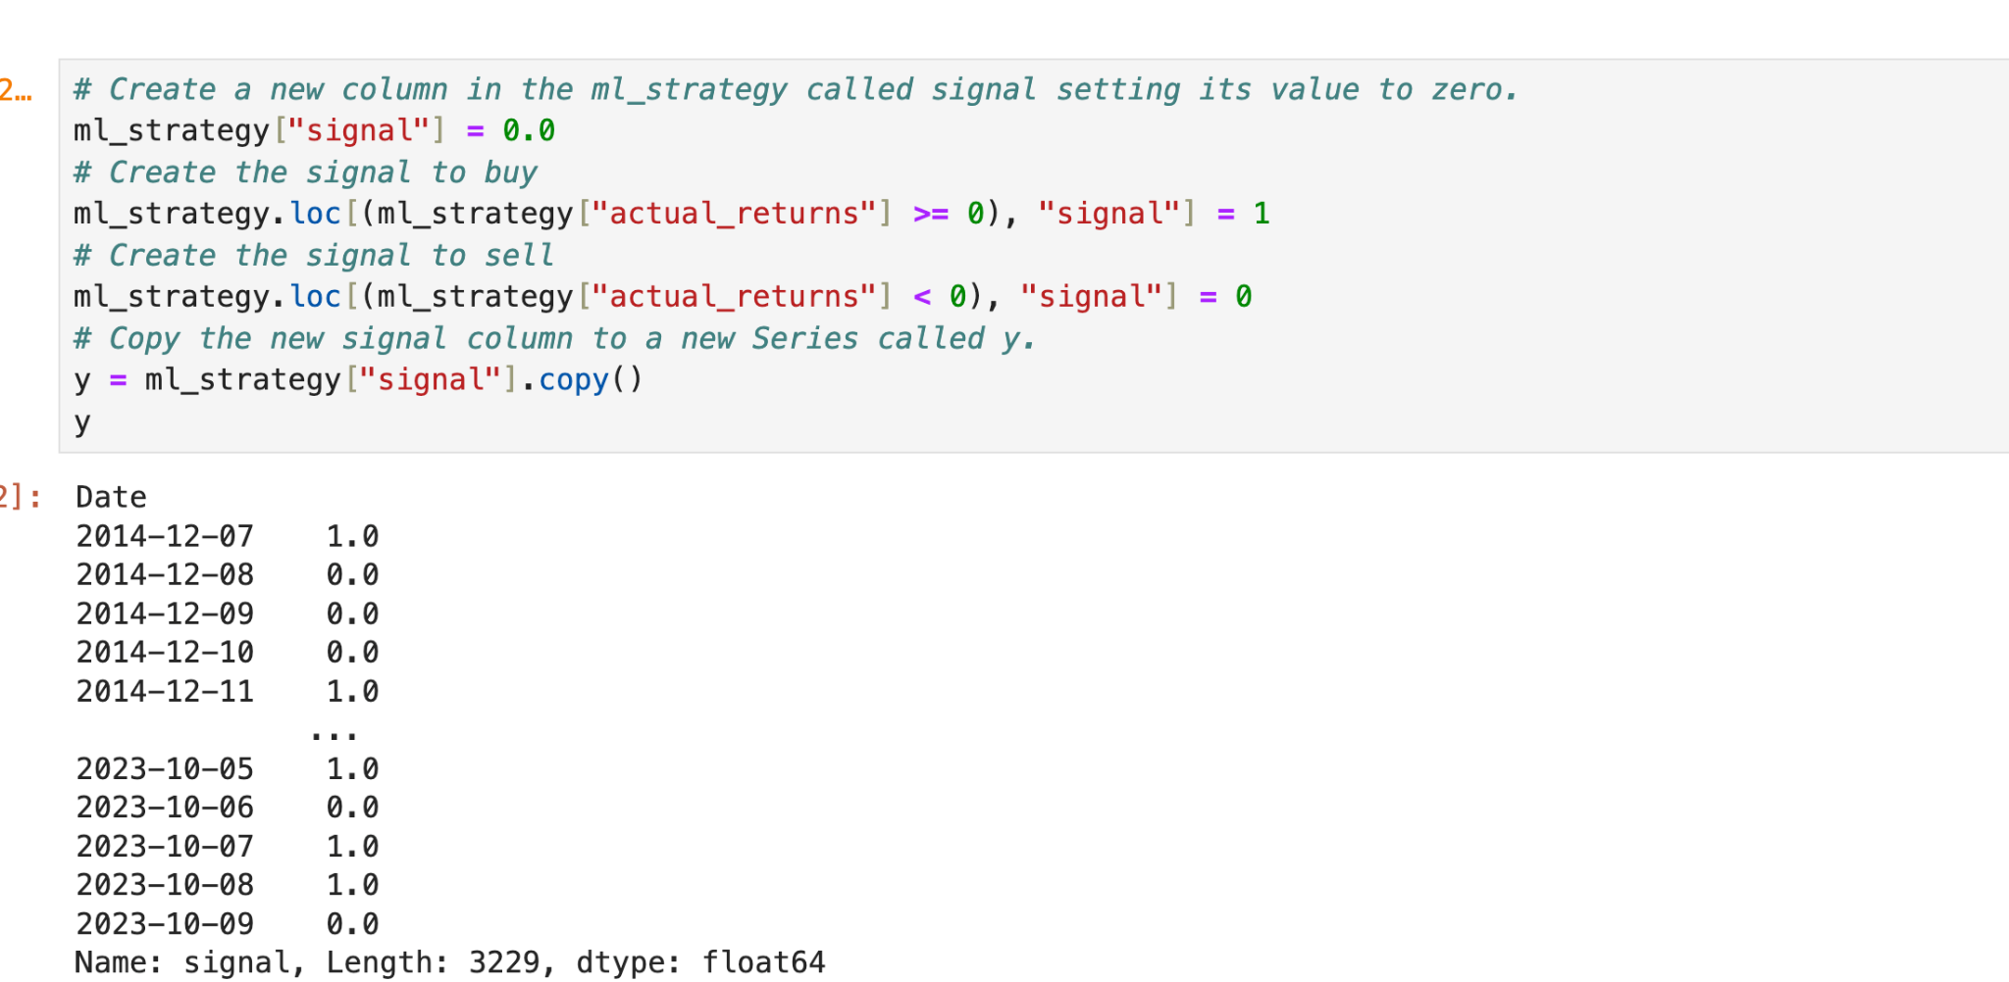
Neural Network Model Summary
Data Feed
Y
Training Window: 60 months

Slide 11
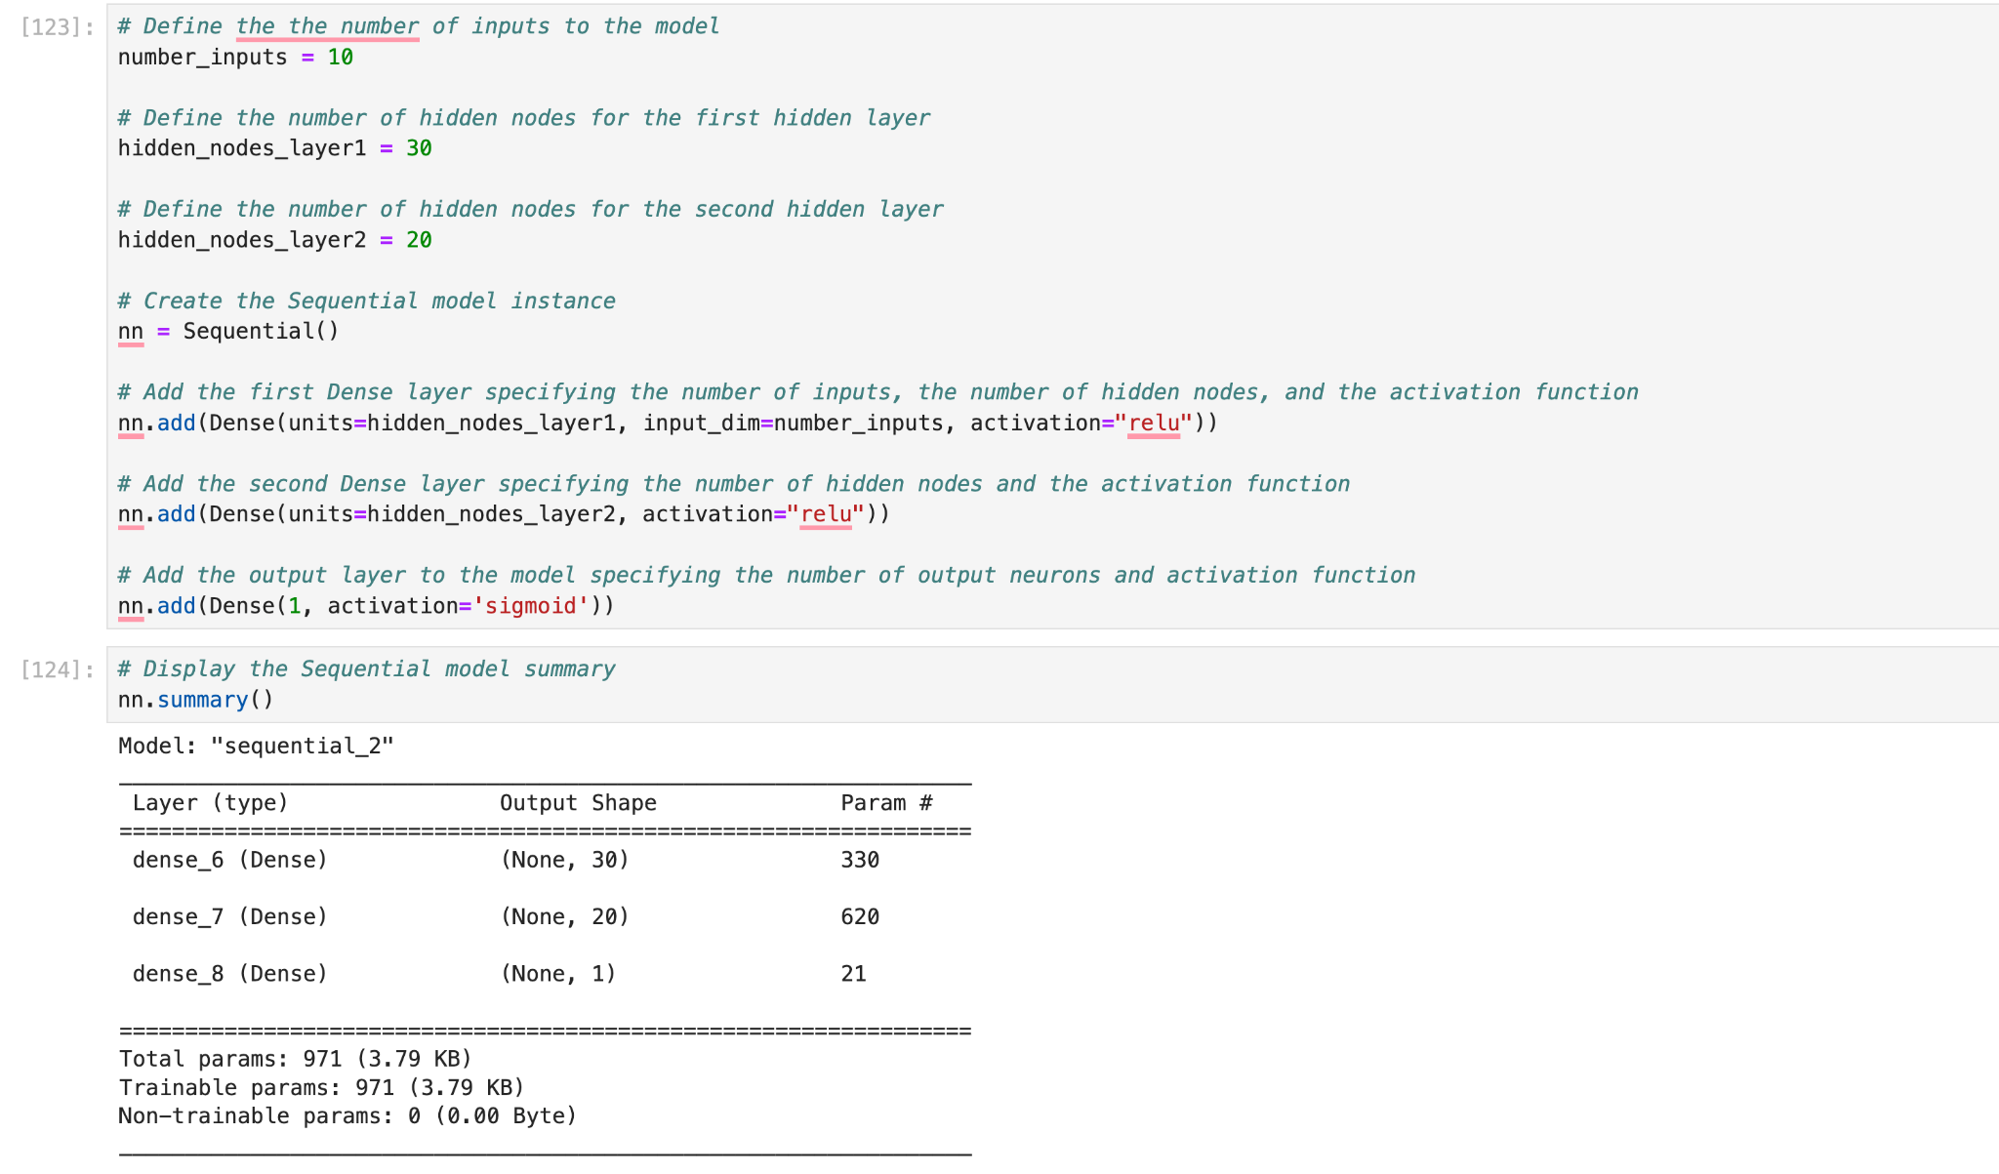
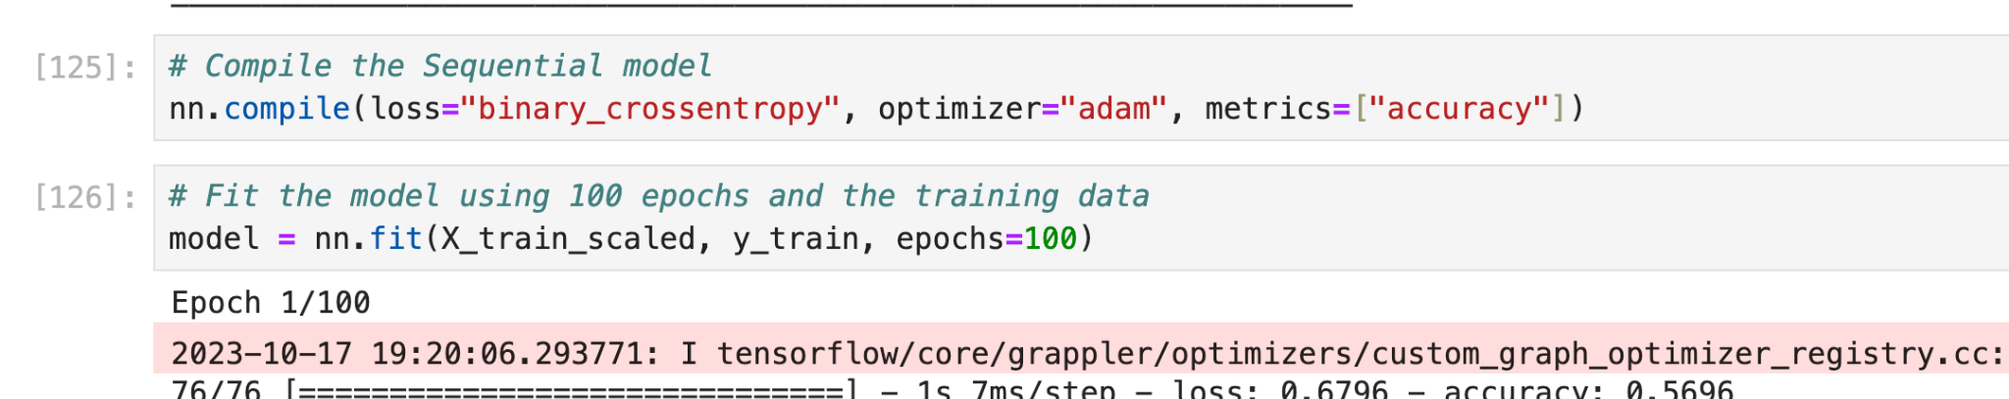
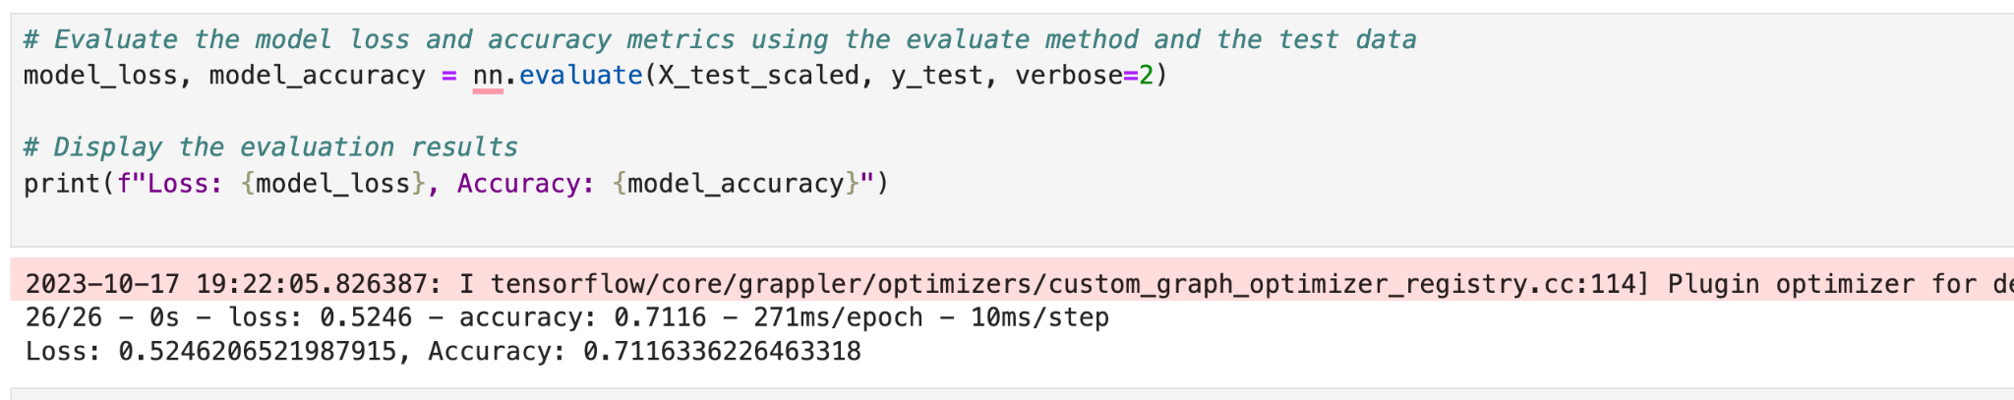
Neural Network Model Summary

Slide 12
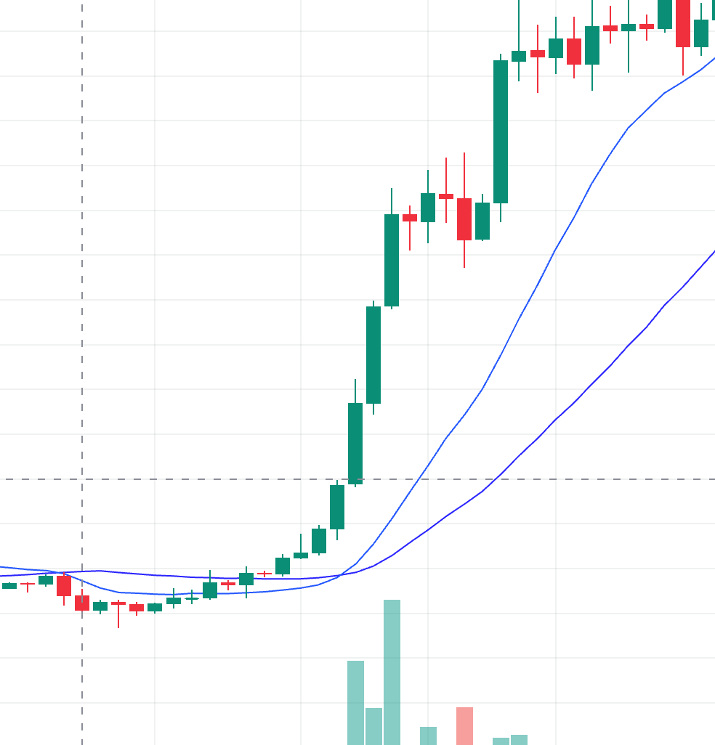
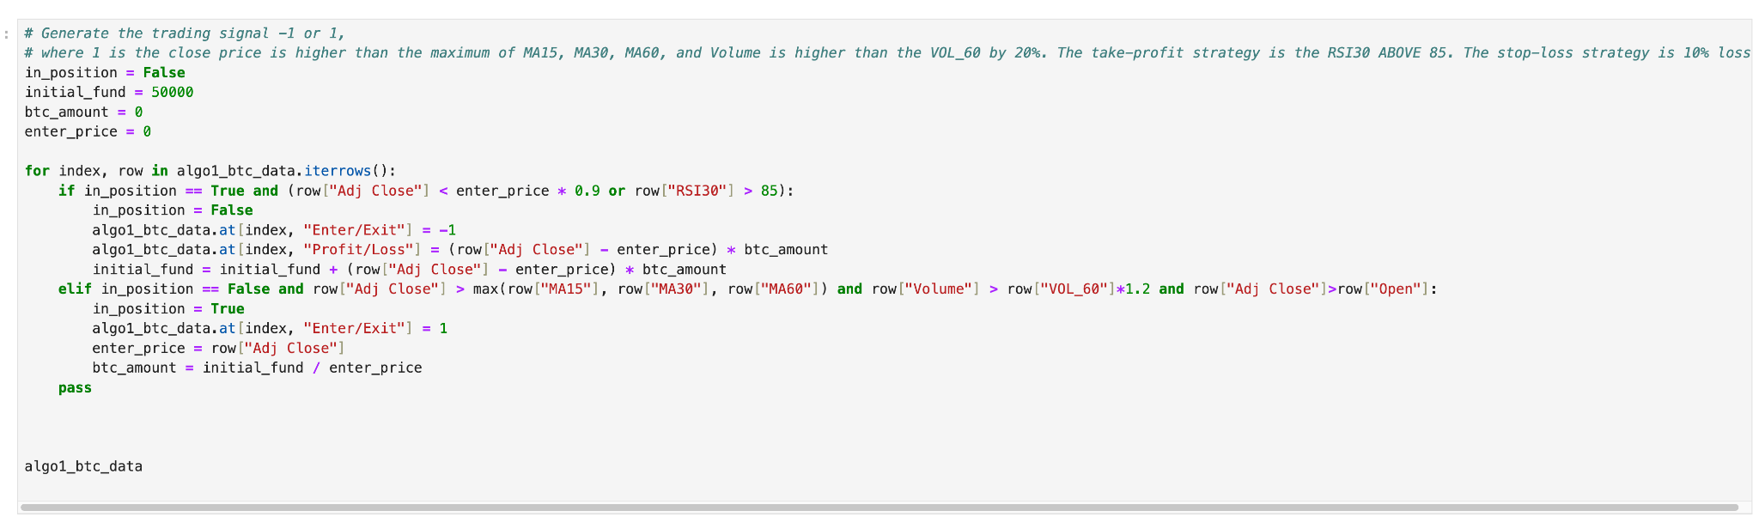
Anna’s algo strategy

Slide 13
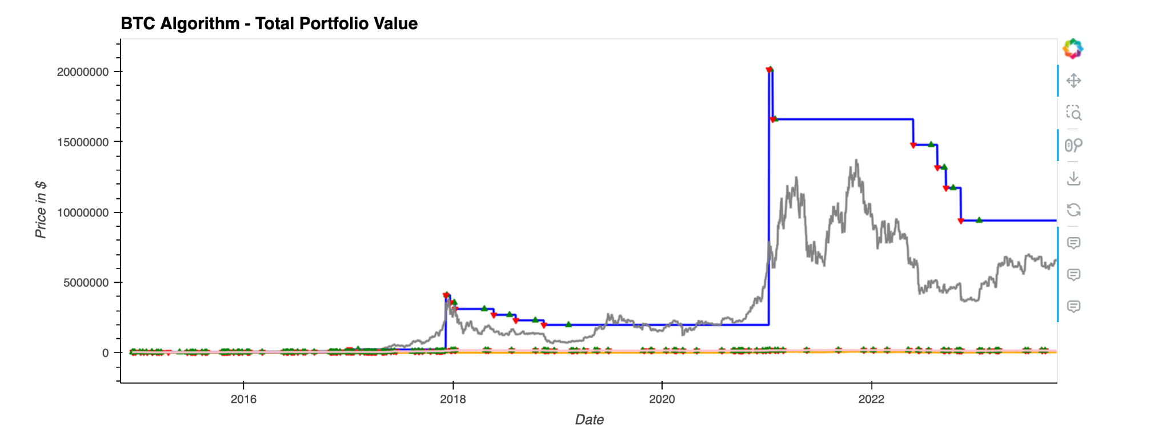
Neuro Network ML vs Anna vs HODL
My algo outperforms (blue line) the HODL strategy(grey line).
Machine strategy is not performing very good (pink line).
*The orange line is BTC close price.
*The initial funds is 50K AUD

Slide 14

Discussion
SVM - The SVM model did outperform the market but i'm not convinced its a reliable model. I believe some more work needs to be done on the model to prove its robustness and also to minimise drawdowns. Cumulative returns was the only metric used to compare the model. Could look at other metrics to help improve it like, f1 score, classification report, accuracy score, etc.
Linear Regression - The model performed very poorly even as it showed an upward trend graph given the R2 score of only .38% which means that it is not able to account for the 99.62% variations between the input and target variables. Either linear regression is too simple for Bitcoin, there is too much noise in the data, or I need to increase the number of features.
Neural Network - The model did not perform as expected, alternative and more fruitful strategies could be incorporated with greater results.

Slide 15

Postmortem
SVM - Had problems with Adaboost and getting the parameters to work with SVM and then outperforming the market. Duke said “he would research Reinforcement Learning as it seems like that it could be a good model to use for trading.” Duke also had an issue with knowing when to shift() indicators and returns in the df.
Neural Network - The data feed to the neural network is not ideal. Probably using the smart money buy signal could be better.
Linear Regression - I need to be familiar enough with exploratory data analysis phase as even though the task and the dataset set seemed straightforward to be able to make informed decision as to what algorithm to use, I still could not figure out what to make of it, e.g., should the period during the bitcoin bubble be considered as outlier, etc.? Over all, machine learning is complicated and yet very interesting subject. I will definitely be training and testing more.

